Slide 1

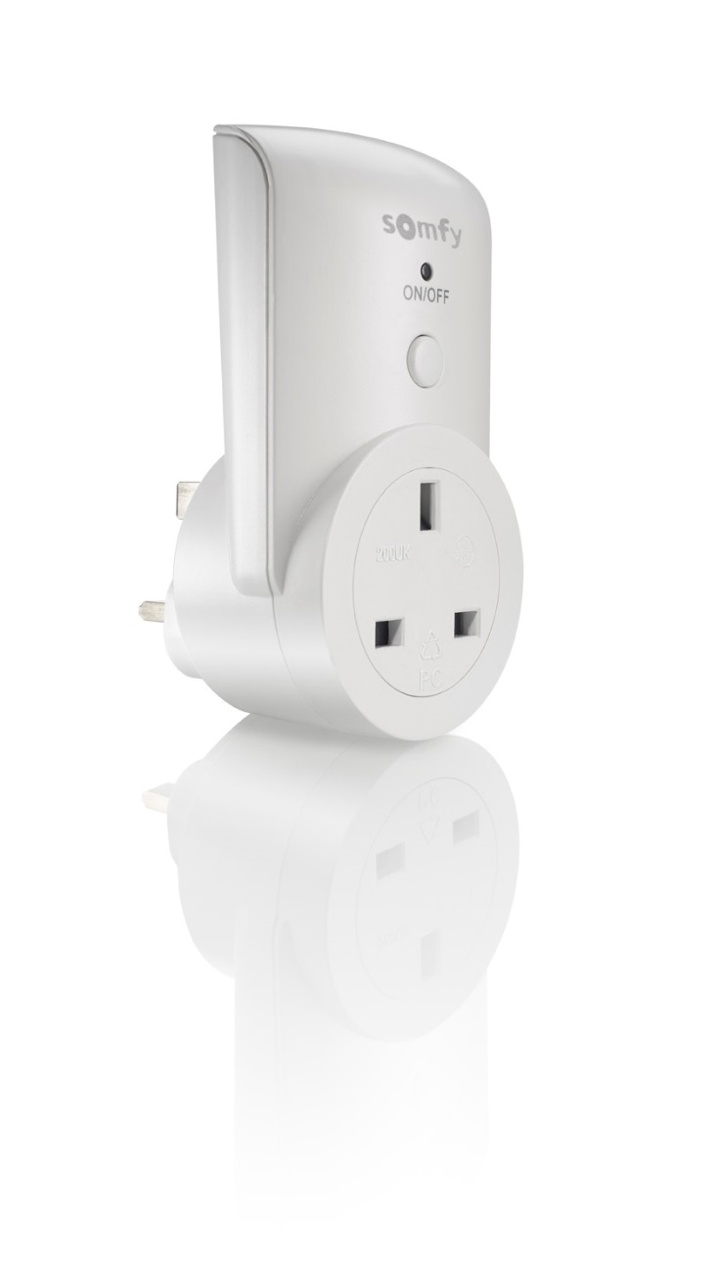
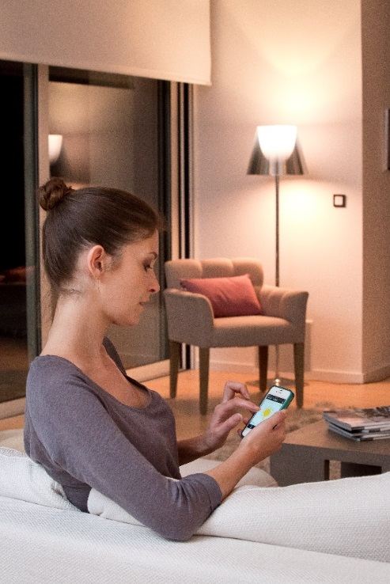

Indoor plug G-type RTS ref: 2401524
What is Indoor plug G-type RTS ?
This remote controlled power outlet with ON/OFF function is used to control remotely lighting and electrical appliances. The power outlet is easy to use, plug the receiver into the electrical outlet and turn on or off the lighting with your smartphone/tablet with the Connexoon RTS* box or the Smart Home box TaHoma*. The power outlets can also be controlled by a Somfy handset, eg. Telis remote control. The power outlet is also equipped with an on/off button on the front.
The first step towards a smarter home is often through remote-controlled electrical outlets that can be easily expanded. With these remote controlled power sockets, you directly get products that are compatible with Connexoon RTS* or Smart Home TaHoma* - your hubs for the smart home of the future!
Advantages:
- Easy to install in your system
- Controls both lighting and electrical appliances.
- Simple and comfortable use.
* Sold separately

Slide 2
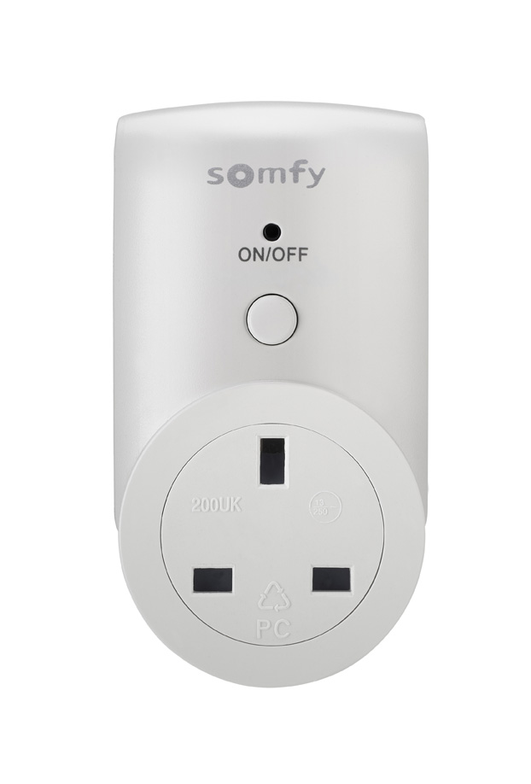




Indoor plug G-type RTS is compatible with:
Lighting & electrical appliances RTS
Indoor Plug On/OFF
Indoor Plug On/OFF RTS
Technical specification
Power Supply | 240V, 50 Hz, 13 A
Max. Power | 3000W (resistive load)
Protocol | RTS
Type | G-socket
Frequency | 433.050 MHz - 434.790 MHz
Range | 30m in open space
IP-classification | IP20, indoor use only
Temperature | 0°C to 40°C
Warranty | 2 years
Commissioning
Connexoon RTS:
-Power and connect the Connexoon RTS box
-Press the prog-button 2 sec. on the Indoor Plug G-type RTS
-Short press on the prog-button on the Connexoon RTS box
TaHoma box:
-Power and connect the TaHoma box
-Go to “Configuration” up in the menu in the right hand corner.
-Choose RTS and “add”.
-Select “plug” in the icon selection tab.
-Choose without remote.
-Press 2 sec. on the prog-button on the Indoor Plug G-type RTS
-Click on “add”-button in the interface.
-Follow the steps on the screen.
Contact
Somfy customer service:
email: sales.uk@somfy.com
phone: 0113 3913030
Address:
Moorfield Road
Yeadon
West Yorks
LS19 7BN
www.somfy.co.uk

